Slide 1
Peer-to-Peer (P2P) File Sharing Network
Simulation Project
By [Battina Tanush Balaji]
Reg No: 24BCE5018

Slide 2
Problem Statement
Client-server file sharing overloads central servers when multiple users download the same file.
This causes network congestion and slower download speeds.
Peer-to-Peer (P2P) networking allows peers to share file parts directly, improving performance.

Slide 3
Objective
Simulate a P2P file sharing network.
Show how peers exchange file chunks without a central server.
Compare performance with traditional client-server approach.

Slide 4
Methodology
Create virtual peers in simulation.
Split file into small chunks.
Peers exchange missing chunks with each other.
Track chunk ownership using a lookup table.
Measure and compare download times.

Slide 5
Tools Required
Python (Sockets, Threading)
Matplotlib for performance visualization
Optional: Mininet for realistic network delays

Slide 6
Expected Outcome
Faster file distribution in P2P compared to client-server.
Reduced load on any single server or network link.
Demonstration of scalable file sharing.

Slide 7
Strengths
Scalable – more peers means faster distribution.
No dependency on a central server.
Efficient use of available bandwidth.

Slide 8
Limitations
Requires peers to stay online for complete sharing.
Security risks without encryption.
More complex peer management compared to client-server.

Slide 9
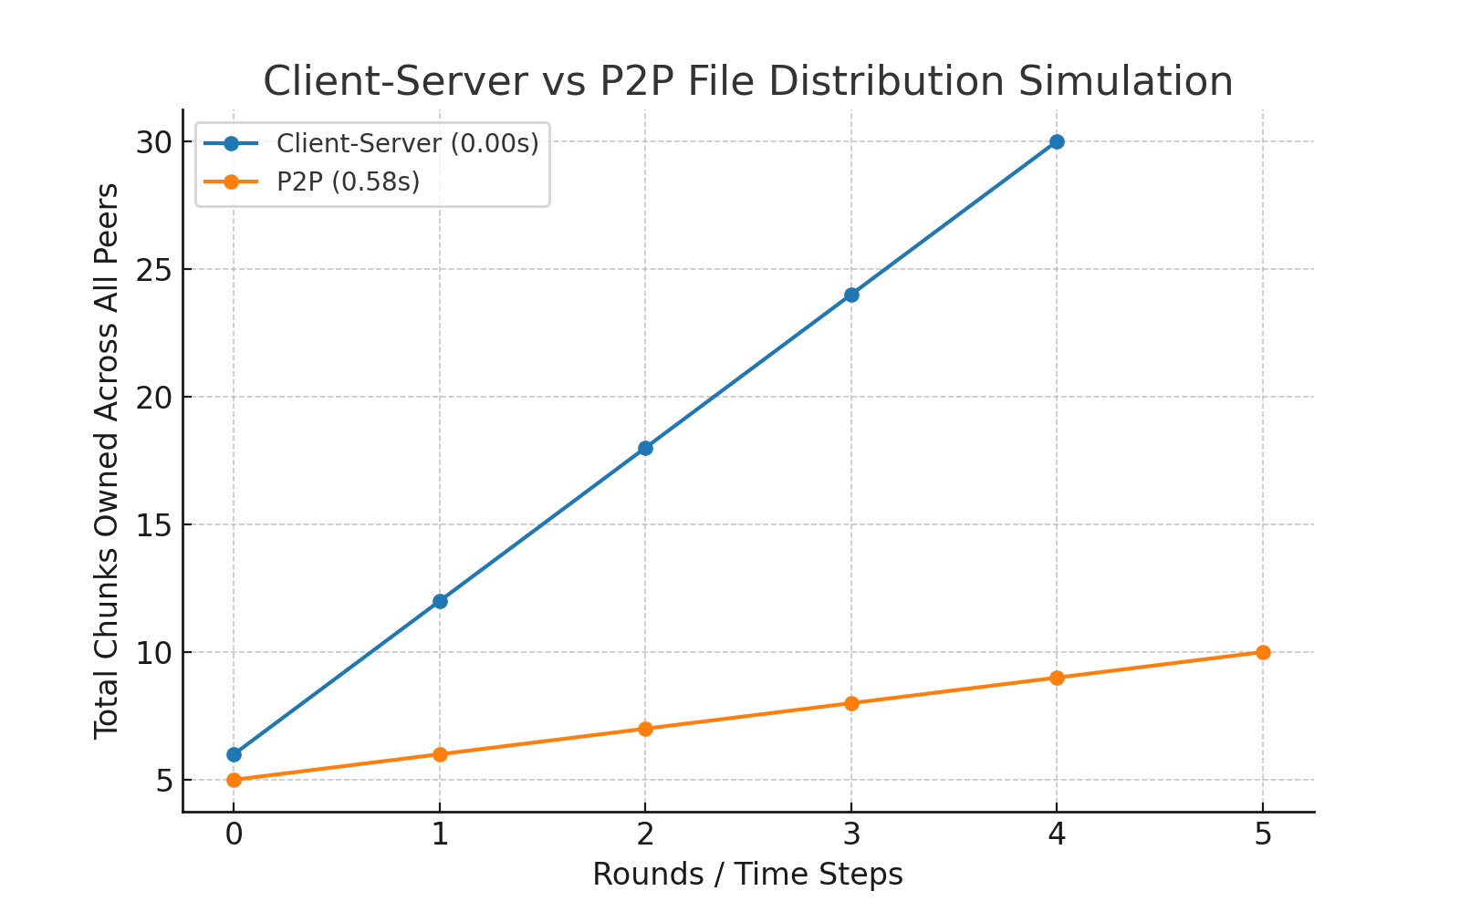
Comparing Client-Server and P2P file sharing
Server Load: High (Client-Server) vs Low (P2P).
Scalability: Limited (Client-Server) vs High (P2P).
Speed: Slows with more users (Client-Server) vs Improves with more peers (P2P).
Reliability: Single point of failure (Client-Server) vs No single point of failure (P2P).

Slide 10
How P2P Works
The file is split into smaller chunks.
Peers share the chunks they have directly with others.
More peers mean faster distribution as multiple chunks are shared simultaneously.
This process continues until all peers have all chunks.

Slide 11
Real-World Uses of P2P
File sharing platforms like BitTorrent and qBittorrent.
Blockchain networks such as Bitcoin and Ethereum.
P2P-assisted video streaming platforms.
Distributed cloud storage systems like IPFS.

Slide 12
Conclusion
P2P networking improves file sharing efficiency.
Can be used in large-scale networks to reduce server load.
Simulation helps visualize benefits over traditional methods.

Slide 13
THANK YOU

